Slide 1
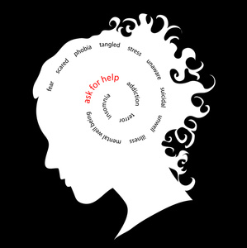
Navigating Mental Health Issues in a Post-Pandemic World
Billy Bilbray
MS, LISAC, Clinical Supervisor

Slide 2
Navigating Mental Health Issues in a Post-Pandemic World
According to the Statista Research Department:
The coronavirus disease (COVID-19), first identified in December 2019,
has resulted in a global pandemic which continues
to impact people in many ways.
The number of cases has continued to rise, with cases and deaths continuing to rise in many countries, while the impact of social distancing and quarantine measures has had a measurable impact on the economy.

Slide 3
Navigating Mental Health Issues in a Post-Pandemic World
The combination of the direct effects
of the disease on individuals and their families
the indirect effect on financial security, housing,
unemployment, and social isolation
has led to an increase in emotional and
psychological challenges worldwide, with specific
populations being disproportionately affected.

Slide 4
Navigating Mental Health Issues in a Post-Pandemic World
Worry
Stress
Anxiety
and other emotional responses are to be expected during such times of instability, and for those already suffering mental illness, the extra pressure serves to exacerbate their condition.
An additional challenge for those experiencing mental distress during the pandemic is that social distancing regulations make it more difficult to access appropriate mental healthcare services.

Slide 5
Navigating Mental Health Issues in a Post-Pandemic World
According to the CDC:
Pandemics can be stressful.
The coronavirus disease 2019 (COVID-19) pandemic may be stressful for people.
Fear and anxiety about a new disease and what could happen can be overwhelming and cause strong emotions in adults and children.
Public health actions, such as social distancing, can make people feel isolated and lonely and can increase stress and anxiety.
However, these actions are necessary to reduce the spread of COVID-19.
Coping with stress in a healthy way will make you, the people you care about, and your community stronger.

Slide 6
Navigating Mental Health Issues in a Post-Pandemic World
Stress during an infectious disease outbreak can sometimes cause the following:
Fear and worry about your own health and the health of your loved ones, your financial situation or job, or loss of support services you rely on.
Changes in sleep or eating patterns.
Difficulty sleeping or concentrating.
Worsening of chronic health problems.
Worsening of mental health conditions.
Increased use of tobacco, and/or alcohol and other substances.

Slide 7
Navigating Mental Health Issues in a Post-Pandemic World
We do not need Statista or the CDC to tell us that this pandemic has been a tremendous challenge for us all.
For many of us it has been the most challenging event of our lifetimes.
The numbers are starting to come out.
The true effect will not be known for years, and perhaps generations.

Slide 8
Navigating Mental Health Issues in a Post-Pandemic World
The following graph shows the increase in both anxiety and depression from a
period of 6 months in 2019 compared to a
6-day period in May of 2020.

Slide 9
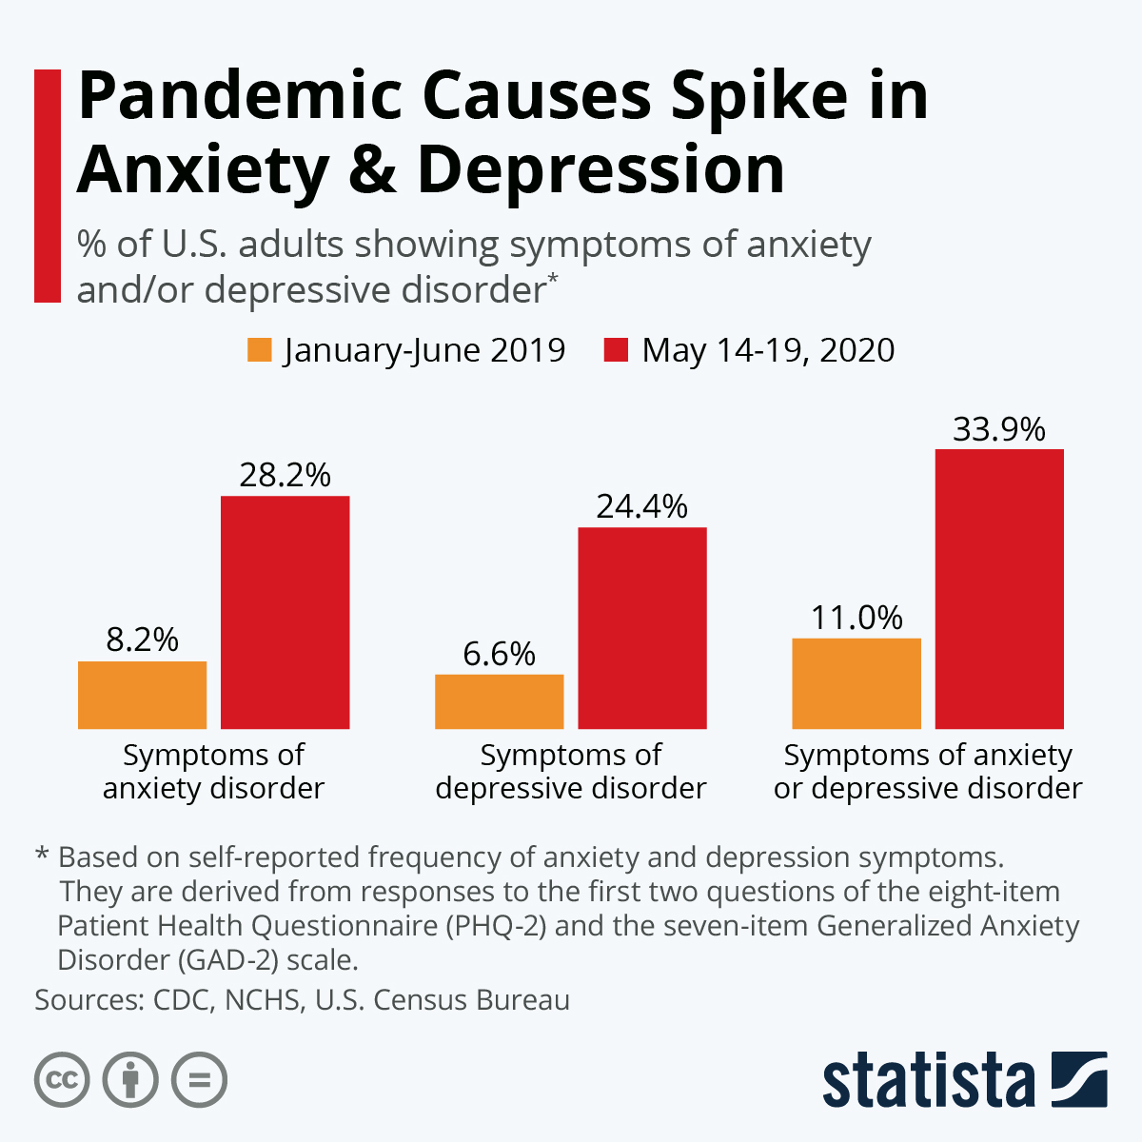

Slide 10
Navigating Mental Health Issues in a Post-Pandemic World
Another indicator of an increase in mental health issues is the immediate increase in medications to treat anxiety, depression, and insomnia.

Slide 11
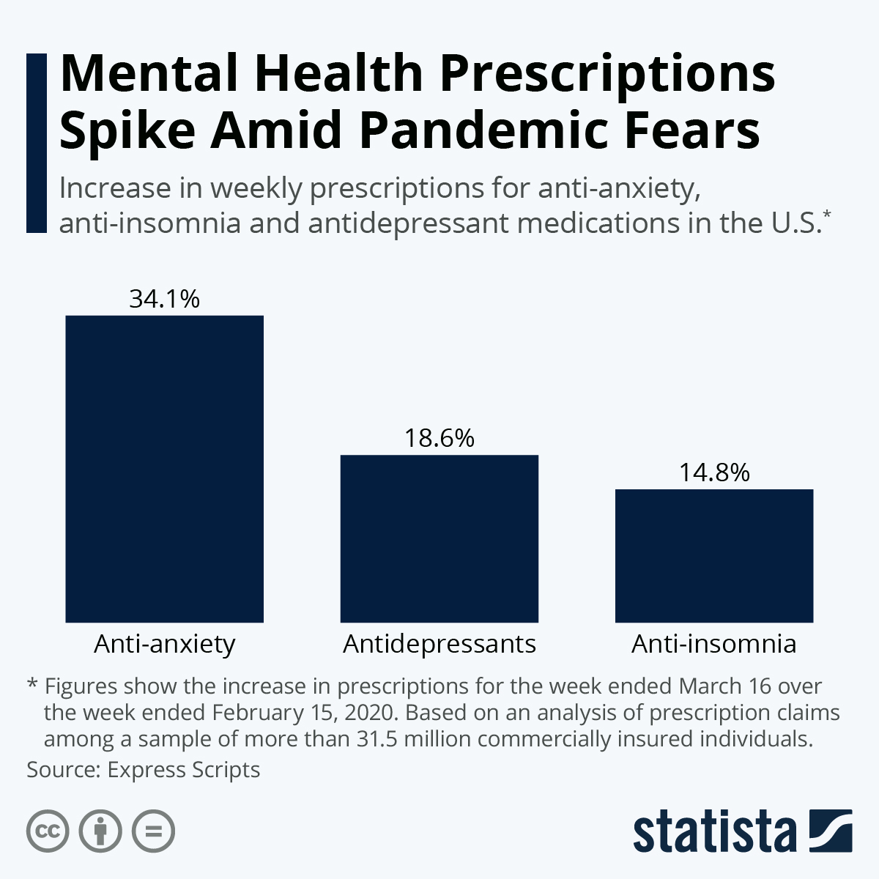
Navigating Mental Health Issues in a Post-Pandemic World

Slide 12
Navigating Mental Health Issues in a Post-Pandemic World
According to a World Health Organization survey performed in October 2020:
“The COVID-19 pandemic has disrupted or halted critical mental health services in 93% of countries worldwide while the demand for mental health is increasing”

Slide 13
Navigating Mental Health Issues in a Post-Pandemic World
A survey of 130 countries provides the first global data showing the devastating impact of COVID-19 on access to mental health services and underscores the
urgent need for increased funding.

Slide 14
Navigating Mental Health Issues in a Post-Pandemic World
Countries reported widespread disruption of many kinds of critical mental health services:
Over 60% reported disruptions to mental health services for vulnerable people, including children and adolescents (72%), older adults (70%), and women requiring antenatal or postnatal services (61%).
67% saw disruptions to counseling and psychotherapy; 65% to critical harm reduction services; and 45% to opioid agonist maintenance treatment for opioid dependence.

Slide 15
Navigating Mental Health Issues in a Post-Pandemic World
More than a third (35%) reported disruptions to emergency interventions, including those for people experiencing prolonged seizures; severe substance use withdrawal syndromes; and delirium, often a sign of a serious underlying medical condition.
30% reported disruptions to access for medications for mental, neurological and substance use disorders.
Around three-quarters reported at least partial disruptions to school and workplace mental health services (78% and 75% respectively).

Slide 16
Navigating Mental Health Issues in a Post-Pandemic World
Youth and the Pandemic
According to a November 2020 article in the Washington Post:
“Since the coronavirus arrived, depression and anxiety in America have become rampant. Federal surveys show that 40 percent of Americans are now grappling with at least one mental health or drug-related problem. But young adults (ages 18 – 24) have been hit harder than any other age group, with 75 percent struggling.”

Slide 17
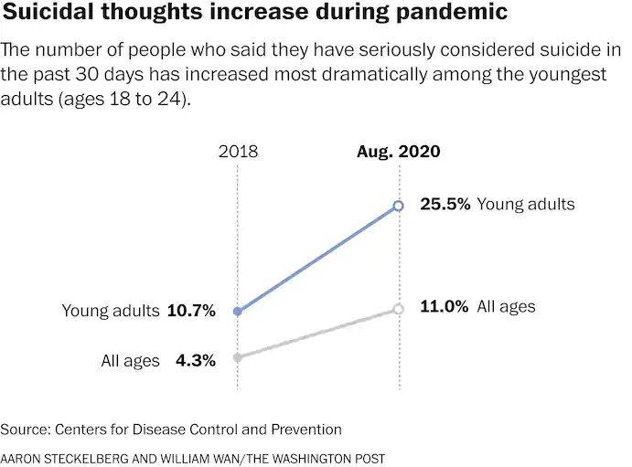
Navigating Mental Health Issues in a Post-Pandemic World

Slide 18
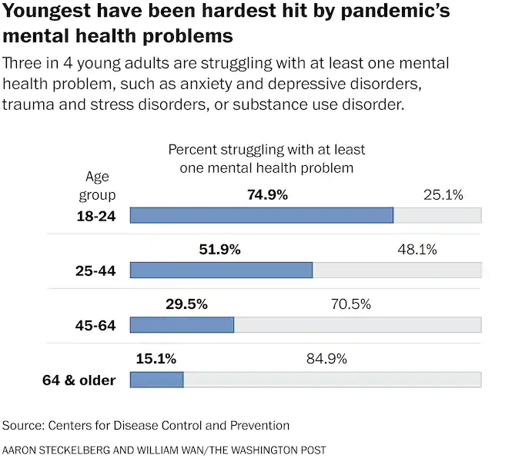
Navigating Mental Health Issues in a Post-Pandemic World

Slide 19
Navigating Mental Health Issues in a Post-Pandemic World
People of Color
According to a September 2020 article on the Commonwealth Fund website:
People of Color Are Faring Much Worse During the Pandemic as Existing Inequities Are Exacerbated.

Slide 20
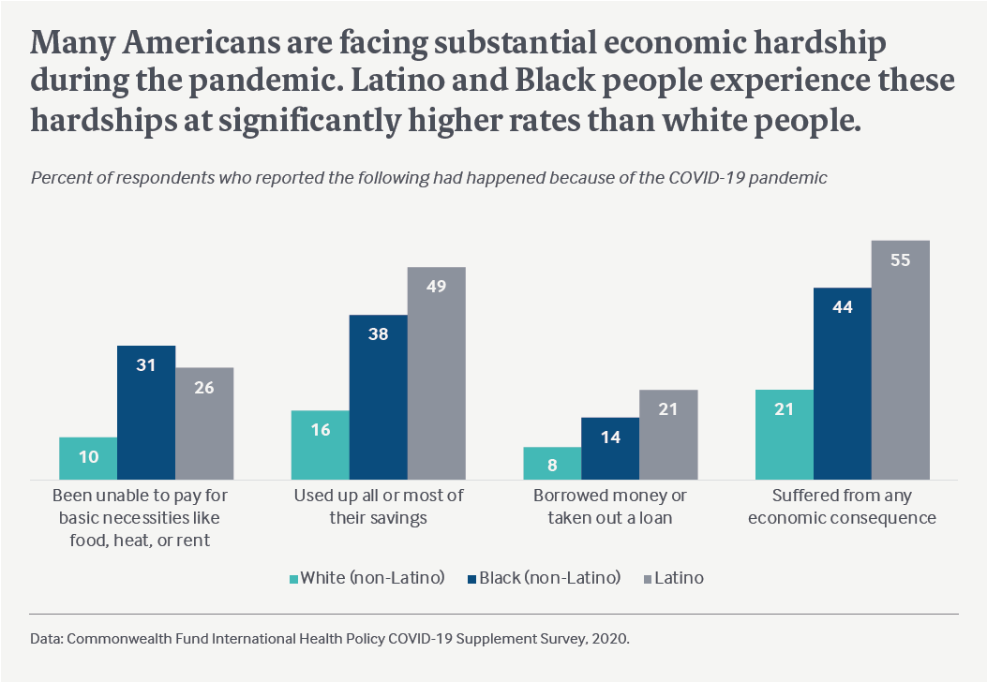
Navigating Mental Health Issues in a Post-Pandemic World

Slide 21
Navigating Mental Health Issues in a Post-Pandemic World
People of Color, Women, and Low-Income Individuals
Latino and Black people, women, and people with low income are most at risk of mental health concerns because of the pandemic.
Many Americans are experiencing mental health problems from COVID-19.
Some groups report having stress, anxiety, or great sadness due to the
pandemic at higher rates. Among them:
39% of women compared to 26% of men. – 40% of Latino and 39% of Black people, compared to 29% of white people.
44% of people with lower income, compared to 26% of people with higher income.

Slide 22
Navigating Mental Health Issues in a Post-Pandemic World
Loss of Smell and Taste
According to a December 2020 article on the Sharp Health News Website:
“Smell and taste have a powerful connection to memory and emotion. A specific scent or flavor can transport us to a meaningful place and time, remind us of a lost loved one, or build excitement for a delicious meal. Losing that connection can have a significant impact on mood and appetite, and lead to both physical and mental health concerns.”

Slide 23
Navigating Mental Health Issues in a Post-Pandemic World
Loss of Smell and Taste
While the loss of these two senses does not seem to be one of the more dangerous symptoms of COVID-19, it can cause distress for those who experience it. People who say their sense of smell or taste was affected by COVID-19 report one or more of the following:
A total loss of smell
A total loss of taste
A constant smoky, burnt plastic, chemical, bitter, sour, feces-like or soapy smell
A metal-, chemical- or plastic-like taste
Loss of appetite
Unintended weight loss
Depression
Anxiety

Slide 24
Navigating Mental Health Issues in a Post-Pandemic World
Loss of Smell and Taste
We know COVID-19 affects both physical and mental health in a variety of ways.
However, research also tells us smell and taste are linked to our memories and emotions, and their loss can lead to depressed mood and anxiety.

Slide 25
Navigating Mental Health Issues in a Post-Pandemic World
As stated before, we do not need numbers and graphs to inform us that we are indeed experiencing challenging times. But as a therapist I am trained to always seek silver linings:
We have a new appreciation for time spent with family and friends
Our environment is catching a break
Many of us parents now know how hard being a teacher really is!
We have been creative with our self-care activities
We are very grateful for the INTERNET (yeah Netflix)!
Many have taken this opportunity to strengthen spiritual connections
Hopefully, we are all a little better at this ZOOM thingy!
What are your Silver Linings?

Slide 26
Navigating Mental Health Issues in a Post-Pandemic World
Thank you!

